Slide 1
Expert Crowds
Professor Chris Callison-Burch

Slide 2
Recruiting is hard
MTurk, CrowdFlower, oDesk, or Freelancer gives us access to a lot of people
But are they useful for specialized skills?

Slide 3
Attracting Contributors via Online Advertising
Panos Ipeirotis spent a sabbatical at Google, and they tasked him with finding experts to fill in their Knowledge Graph
“We have a billion users... leverage their knowledge ...”
“Let’s create a new crowdsourcing system...”
“Crowdsource in a predictable manner, with knowledgeable users, without introducing monetary rewards”
Notes:
One of the challenges in any human computation system is finding a way to motivate people to participate. This is eased somewhat by the fact that most human computation systems rely on networks of unrelated people with connected computers in their homes or workplaces. They need not go anywhere or do anything too far out of their ordinary lives to participate. Even so, since the computations frequently involve small unit tasks that do not directly benefit the contributors, they will only participate if they have a motivation—a reason why doing the tasks is more beneficial to them than not doing them. Unlike a traditional job, which almost always pays with money, human computation workers may be motivated by a number of factors. Still, some workers are paid, so we start there

Slide 4
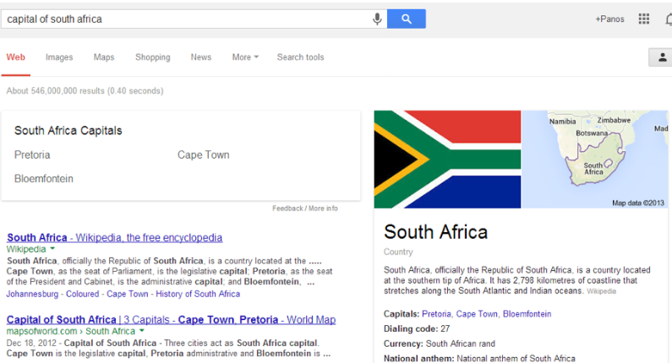
Knowledge Graph: Things not Strings

Slide 5
Still incomplete...
“Symptom of strep throat”
“Side effects of treximet”
“Who is Cristiano Ronaldo dating
“When is Jay Z playing in New York”
“What is the customer service number for Google”
...

Slide 6
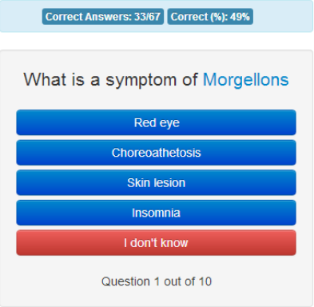
Quizz

Slide 7
Calibration vs. Collection
Calibration questions (known answer): Evaluating user competence on topic at hand
Collection questions (unknown answer): Asking questions for things we do not know
Trust more answers coming from competent users
Tradeoff
Learn more about user quality vs. getting answers
(technical solution: use a Markov Decision Process)

Slide 8
Challenges
Why would anyone come and play this game?
Why would knowledgeable users come?
Wouldn’t it be simpler to just pay?

Slide 9
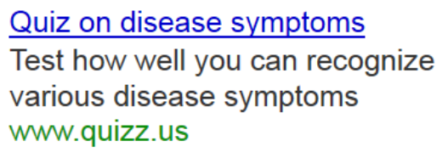
Attracting Visitors: Ad Campaigns

Slide 10
Running Ad Campaigns: Objectives
We want to attract good users, not just clicks
We do not want to think hard about keyword selection, appropriate ad text, etc.
We want automation across thousands of topics (from treatment side effects to celebrity dating)

Slide 11
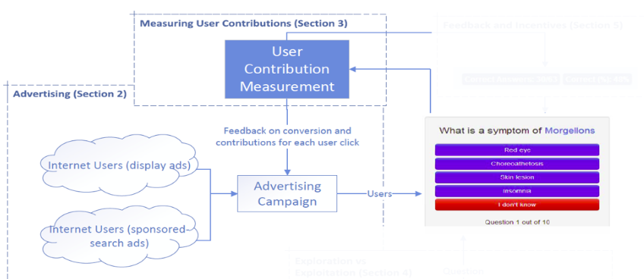
Solution: Treat Quizz as eCommerce Site

Slide 12
Solution: Treat Quizz as eCommerce Site
Feedback: Value of click

Slide 13
Example of Targeting: Medical Quizzes
Medical topics They the best performing quizzes…
Users coming from sites such as Mayo Clinic, WebMD
Likely “prosumers” (proactive consumers, not professionals

Slide 14
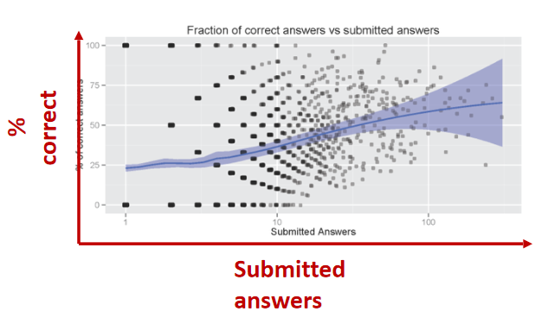
Self-selection and participation
Low performing users naturally drop out
With paid users, monetary incentives keep them

Slide 15
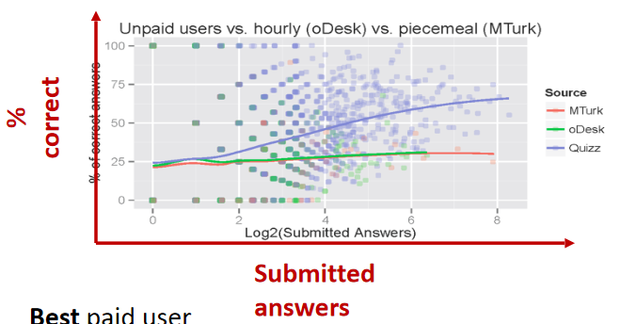
Comparison with paid crowdsourcing
Best paid user
68% quality, 40 answers (~1.5 minutes per question)
Quality-equivalency: 13 answers @ 99% accuracy, 23 answers @ 90% accuracy
5 cents/question, or $3/hr to match advertising cost of unpaid users
Knowledgeable users are much faster and more efficient

Slide 16
Targeted Advertising
New way to run crowdsourcing, targeting with ads
Engages unpaid users, avoids problems with extrinsic rewards
Provides access to expert users, not available labor platforms
Experts not always professionals (e.g., Mayo Clinic users)

Slide 17
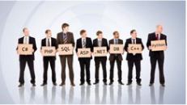


Online Labor Markets
Help employers and employees connect
Face a similar challenge
How do they assess worker skills?

Slide 18


Skill Testing
Skill certification through testing
Workers take online tests
Display score on profile
Tests licensed from companies
Domain-experts paid to create questions
Static question banks

Slide 19
ExpertRating Categories
Airlines and Aviation
Building & Construction
Career guidance
Clothing and Fashion
Engineering
English language skills
Finance & Accounting
Food and hospitality
Foreign language skills
Graphic design
Healthcare
IT & Computer skills
Law
Management
Media
Medical transcription and billing
Office temp skills
Sales and Marketing

Slide 20
Problems
Static Question Banks
Questions become outdated
Cheating
Lack of evaluation
Questionable long-term performance predictors
Questions may have errors or ambiguities

Slide 21
STEP: A Scalable Testing and Evaluation Platform
Christoforaki and Ipeirotis (2014)
Continuously generate new questions
Make tests more cheating proof
Keep questions up-to-date
Evaluate question quality
Identify errors or ambiguities
Use real-market performance data for evaluation

Slide 22
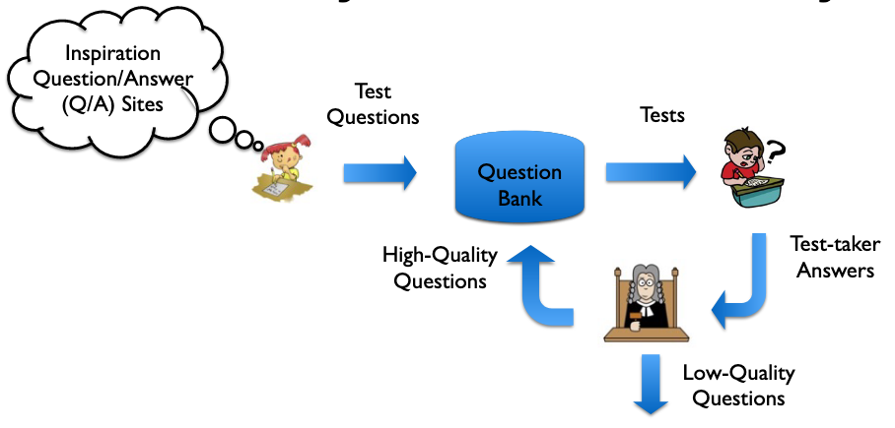
STEP system summary

Slide 23

Stack Overflow
Topic | Questions | %
Java | 737,563 | 8.9
Javascript | 723,150 | 8.7
C# | 714,774 | 8.6
PHP | 658,827 | 8.0
Android | 585,017 | 7.1
Jquery | 545,775 | 6.6
Python | 355,093 | 4.6
HTML | 352,146 | 4.2
C++ | 325,667 | 3.9
mysql | 280,946 | 3.4
“A Q/A site for professional and enthusiast programmers”
3 million subscribed users
8 million questions
35K tags
91% at least one answer

Slide 24
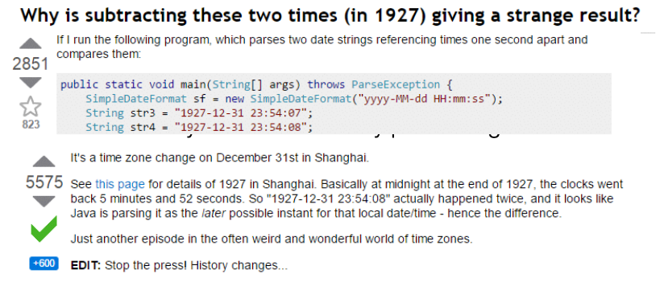
Stack Overflow Challenges
Volume of questions
Large base of candidate questions for tests

Slide 25


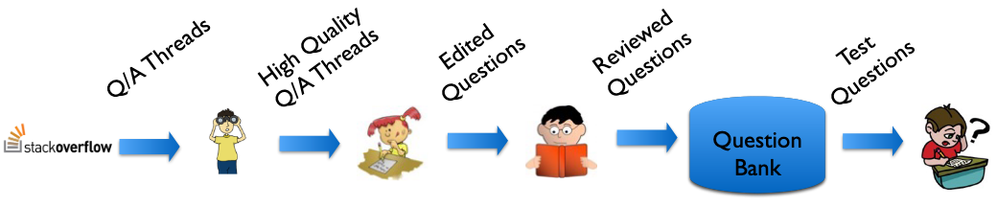
Question Spotter
Identifies promising Q/A threads
Train classifier with obtained labels: ~90% precision
Features
Question text length
Answer count
Answer score entropy
Popularity distribution of tags
Question popularity score
Weekly view count
Max answer author reputation

Slide 26

Question Editor
Humans with expertise in topic at hand
Visit and read promising Q/A thread
Reformulate into multiple choice test-question
Discard questions not considered appropriate

Slide 27

Question Reviewer
Have a good handle of English Language,
Check for spelling, grammar
Check for compliance with test standards
Vocabulary usage
Question text length
Answer count
Answer text length
Reviewers do not need to be topic experts

Slide 28

Question Bank
Experimental Question Bank
Stores newly created questions
Not used for test-taker evaluation
Gather answers waiting for evaluation
Production Question Bank
Are used for the test-taker evaluation

Slide 29
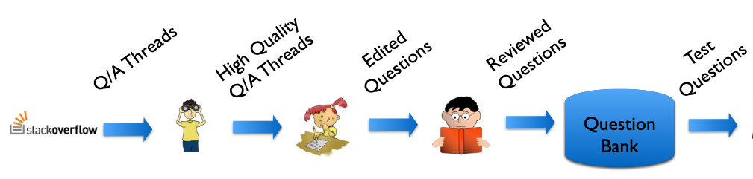
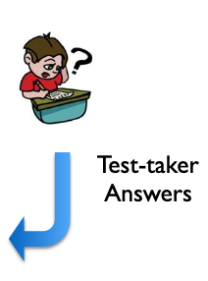



System Overview

Slide 30
Item Response Theory
Test takers have a single ability parameter Ө
Questions are modeled by Item Characteristic Curve:
α: discrimination of the question
β: difficulty of the question

Slide 31
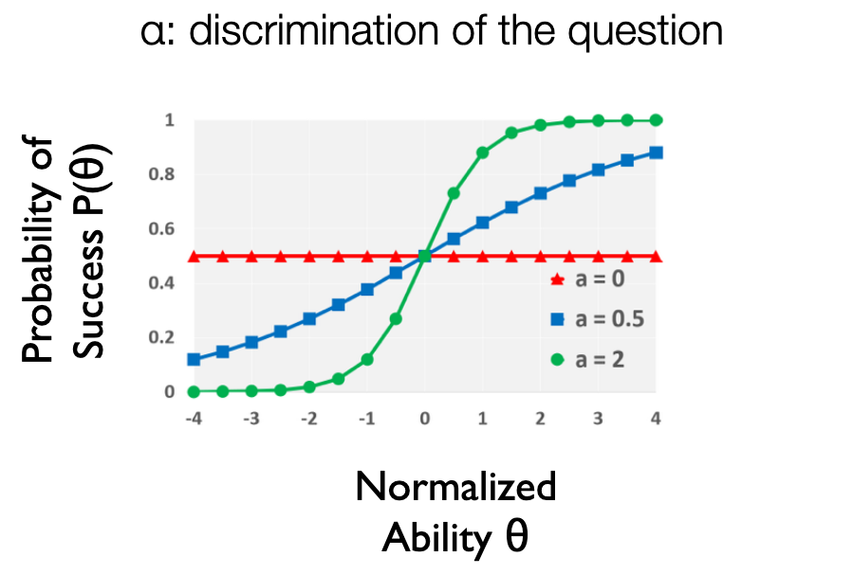
Item Response Theory

Slide 32
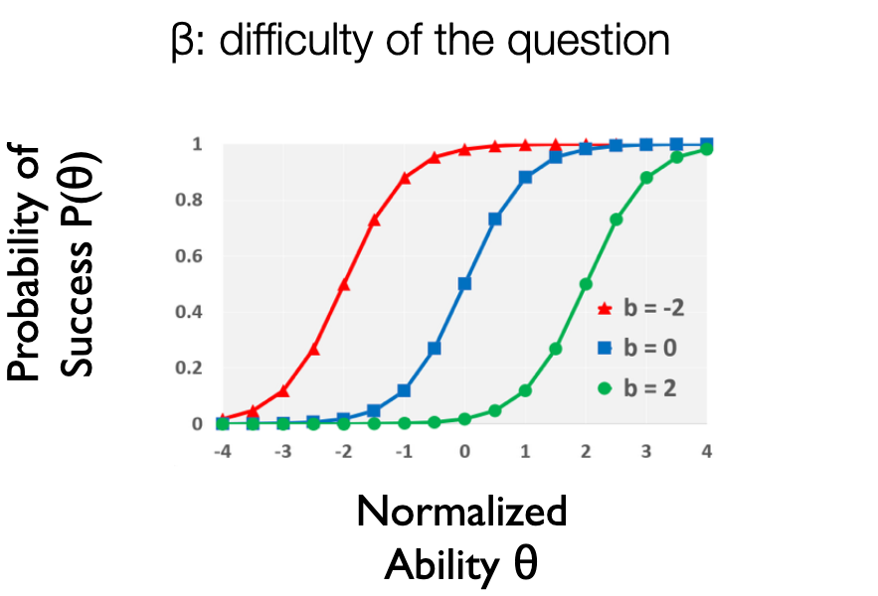
Item Response Theory

Slide 33
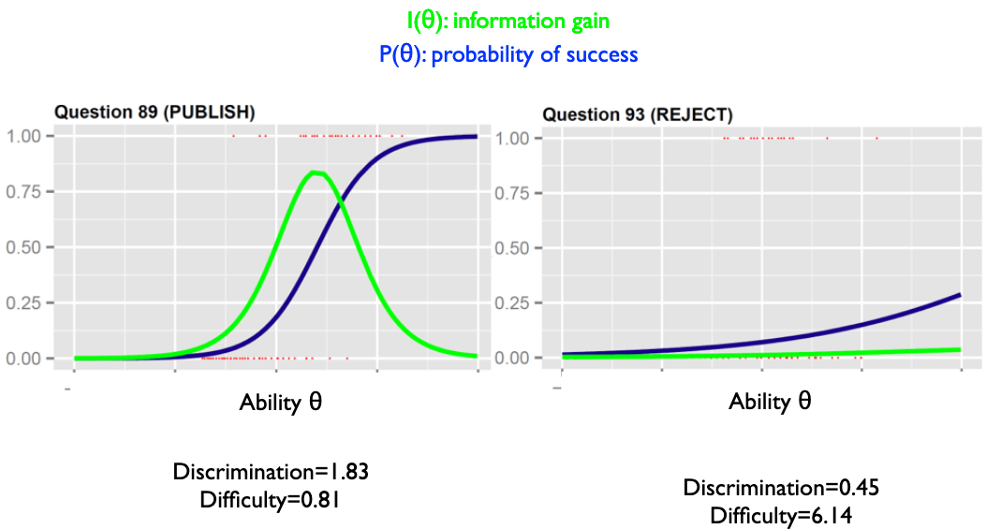
Question Evaluation Theory

Slide 34
Ability measures
Endogenous measures
Ө(u): Test score of candidate u
Fit the function using logistic regression
Derive discrimination and difficulty values for each question

Slide 35
Ability measures
Exogenous measures
Ө(u): Hourly wage of candidate u after taking the test
Use wage data from ODesk
More robust to cheating
Evaluates importance of skills in the marketplace

Slide 36
STEP cost
Using oDesk data
Question cost
Static question bank licensing: $10 per question
STEP: $4 per question
Create question “from scratch” (IKM data): $25 per question

Slide 37
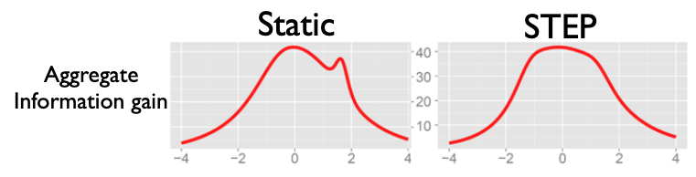
STEP performance
Question quality (Java test example)
Static Question Bank: 87% acceptance rate
STEP generated questions: 89% acceptance rate

Slide 38
STEP
System that continuously generates new questions
Makes tests more cheating-proof
Assesses test quality with real-market performance data
Identify potential errors or ambiguities
Is of equal or higher quality with existing tests
Cheaper to generate questions than licensing

Slide 39
What would the ability to find and
engage experts allow you to do?

